Slide 1
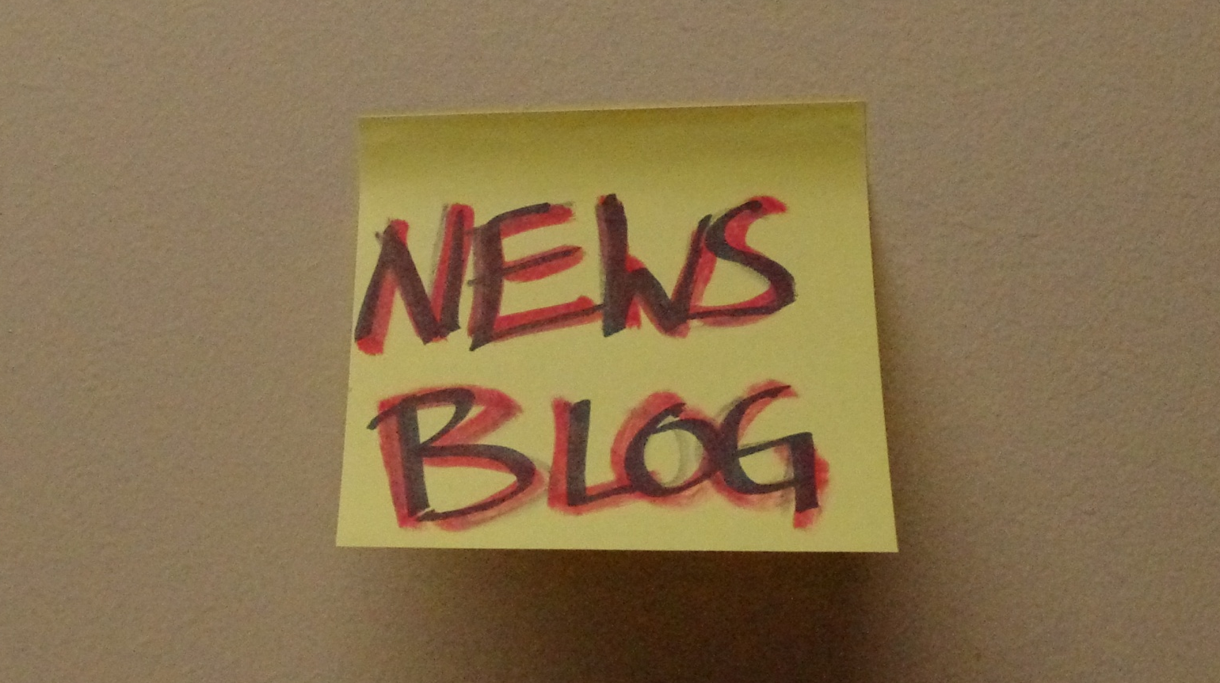
Arlington VA Public Library
Community Engagement
on a Shoestring
Notes:
So we’ve come to this conference year after year and seen amazing Library Websites
But these examples seemed out of reach for us because of technical, staff and budget limitations.
Our presentation today is a case study of how we hijacked a bunch of free tools to create a cohesive and social website for our Library.

Slide 2
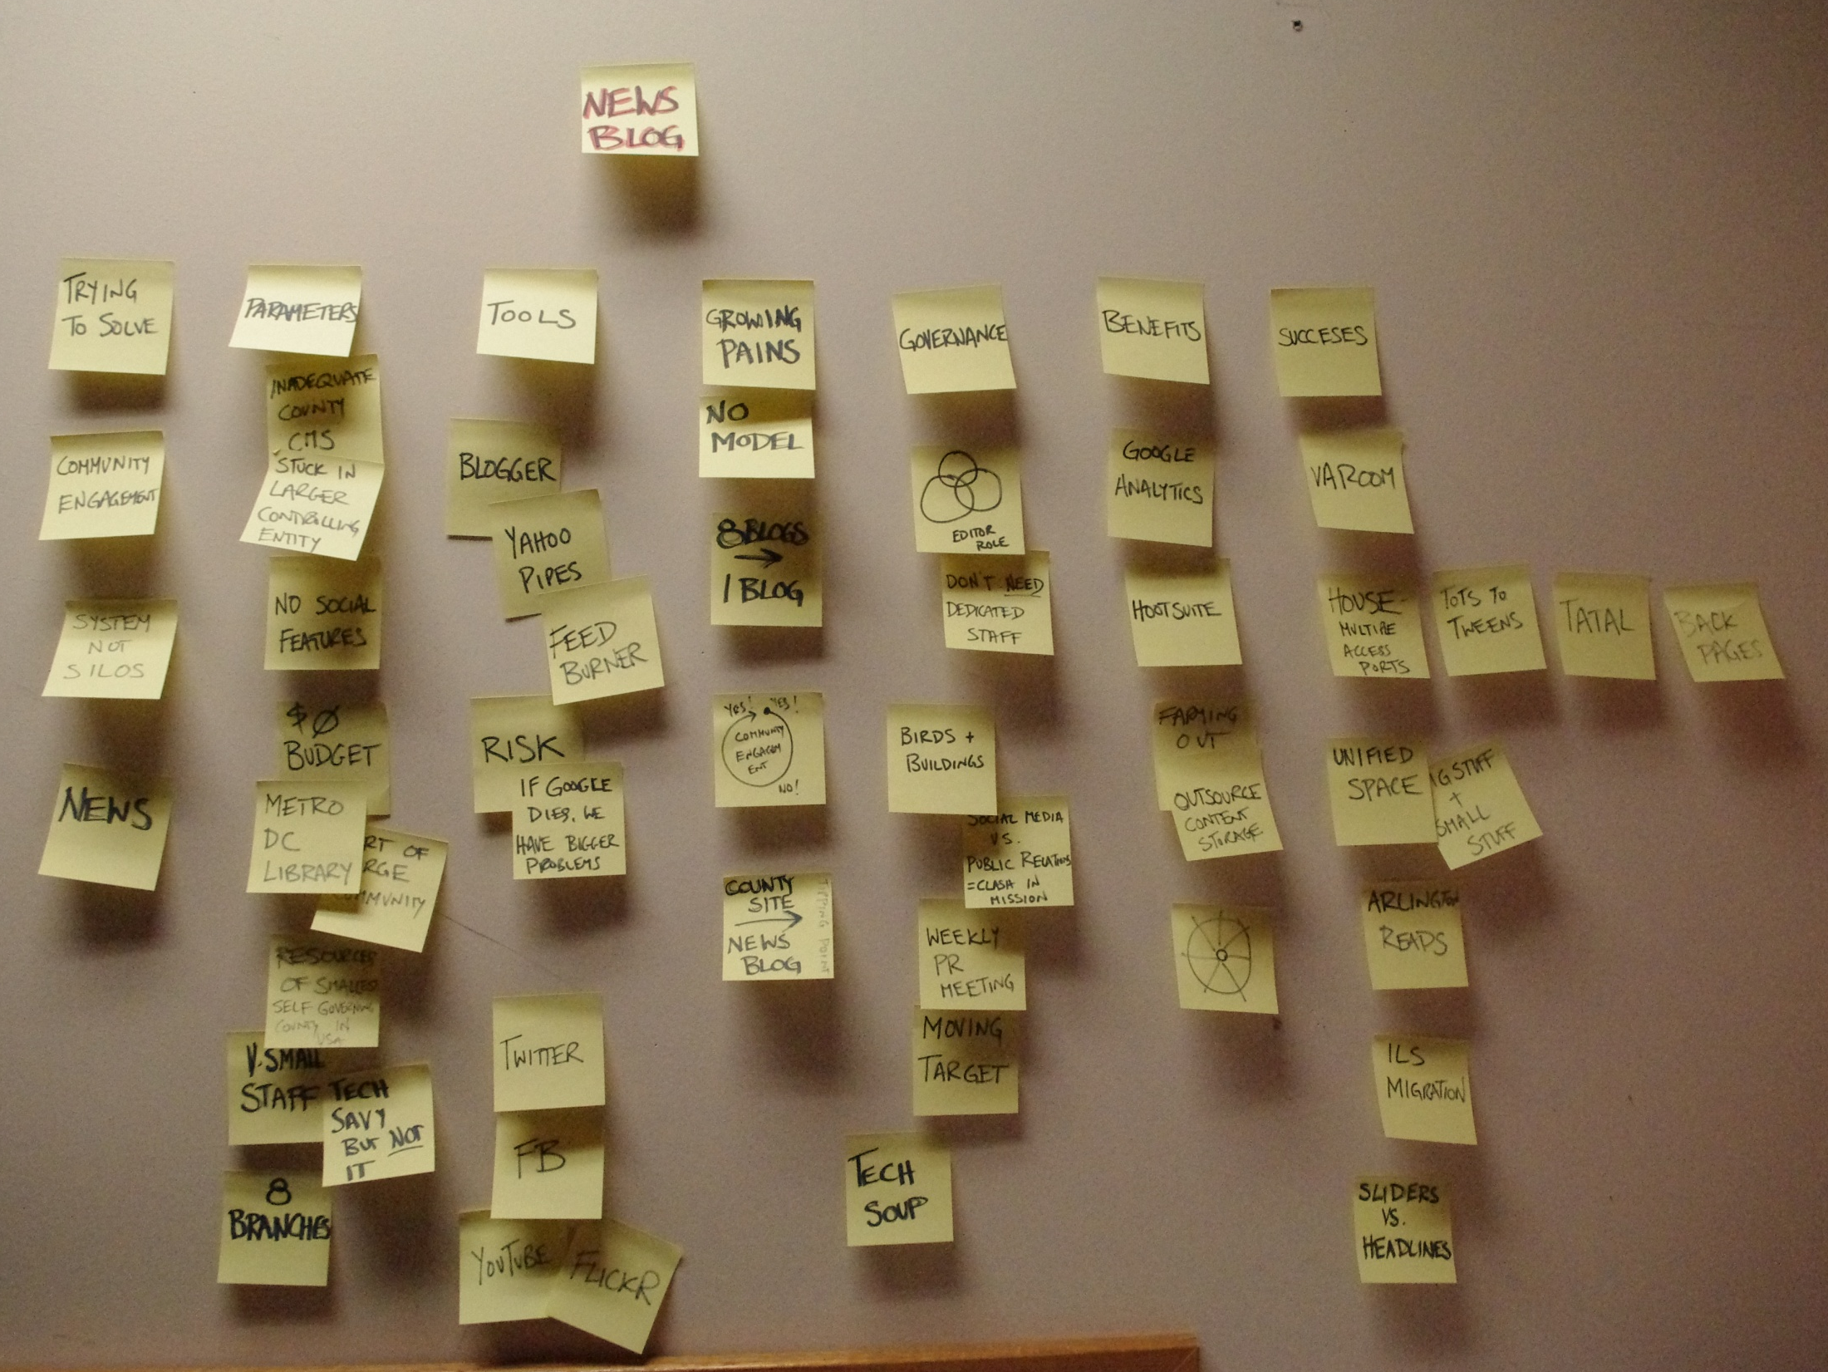
Notes:
You’re going to see a lot of post-its in our presentation.
This is because we just went live on a new Library System and Catalog, and we’ve been so busy that up until last week we thought this photo might actually have to be our whole presentation.
Luckily, it’s not.

Slide 3
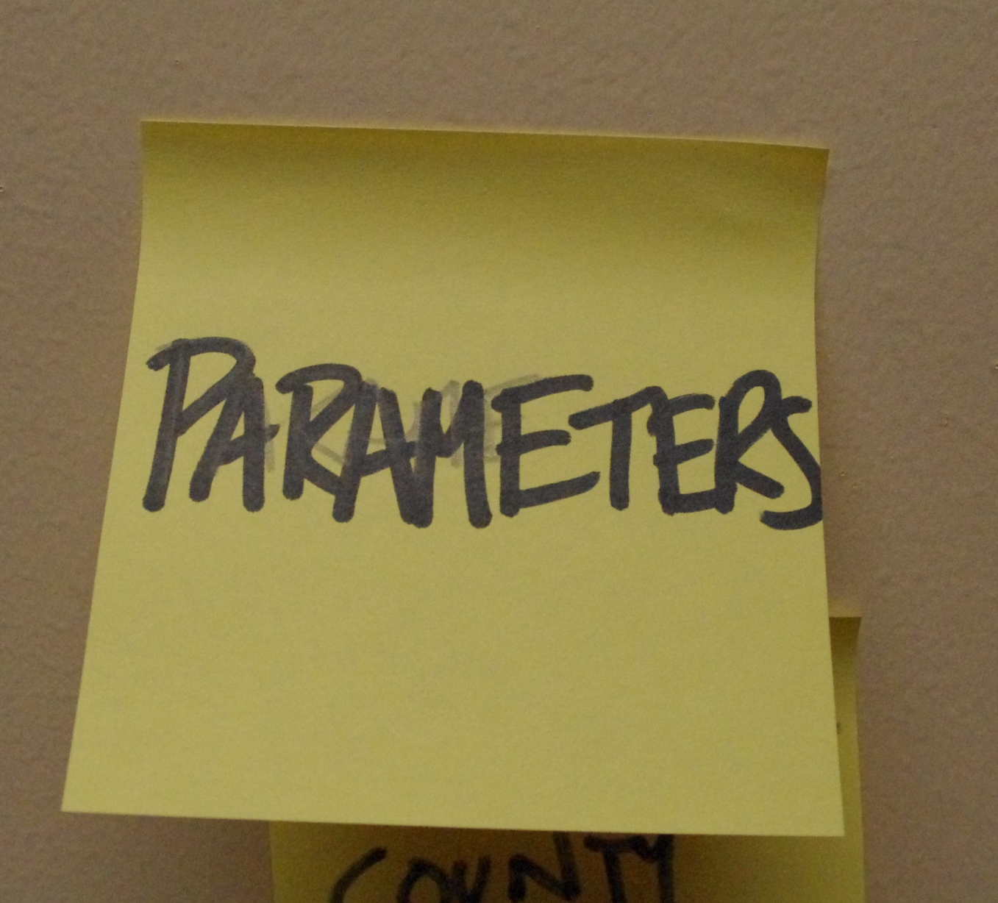
Notes:
So why couldn’t we do all the great things we saw other Libraries doing to improve their sites?
Our library system is probably a lot like some of yours, and we had more than a few constraints.

Slide 4
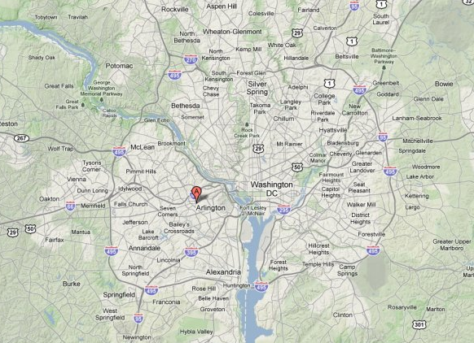
Arlington County
Notes:
To begin with, here’s a snapshot of Arlington County and the Arlington Public Library –
It’s just across the Potomac – so it’s part of the DC area, right on the metro.
Arlington County is the smallest self governing county in the country – more like a small city than a traditional county
The Library is a department of County Government – not an independent agency

Slide 5
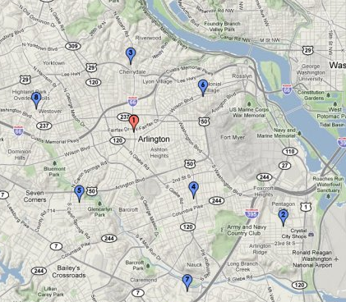
8 Locations in 26 Square Miles
Notes:
So we’re a medium sized public library system -
We have a Central Library, and 7 neighborhood branches
All within 26 square miles
And we serve a population of ~213K people
It’s a dense, diverse population, with a high proportion of tech-savvy people

Slide 6
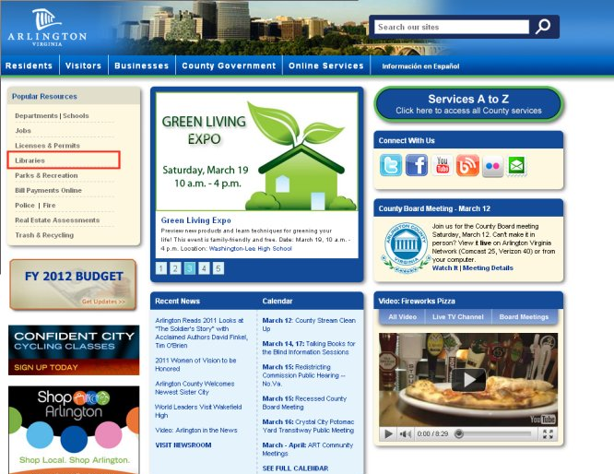
Notes:
The Library relies almost entirely on the County’s IT department for web support
And our site is part of the larger County Website, which you can see here
So we have a very small staff and no dedicated web budget

Slide 7
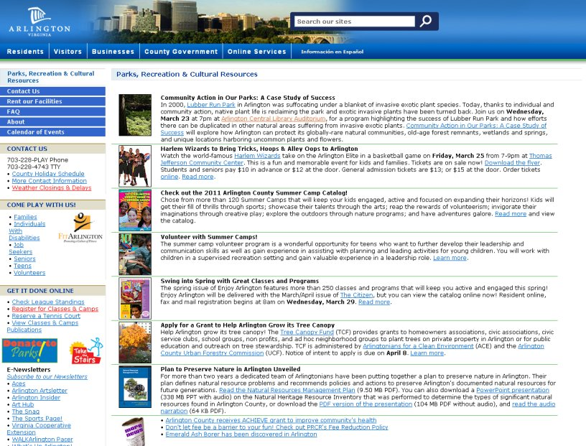
Notes:
What this means is -
We have to use the County’s content management system and we’re not permitted to switch to open source
We also have to use the County’s web page templates
You can see an example of a typical County department page here
The county logo and navigation take precedence at the top of the page.
There’s space for text and pictures, but the layout lacks a way to keep it organized and user friendly
And making frequent updates, which is necessary when promoting news and events, is very tedious.
Worst of all, the underlying system lacks the capacity for implementing website features that users have come to expect

Slide 8
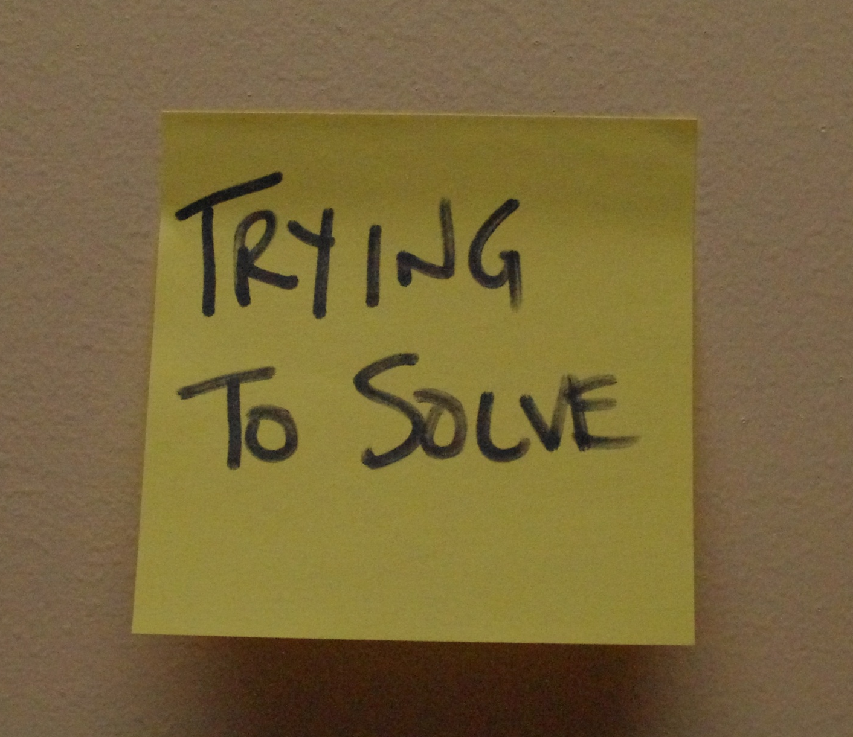
Notes:
We knew we needed something better.
We needed a more modern platform to better hold our news and event information
We also wanted to brand the Library as a single system, but still give each of our branches its own online identity
And we wanted to create a place for community engagement about the Library
So we spent 6 months brainstorming, developing and reorganizing around a brand new idea

Slide 9
Notes:
Up until a year ago our site looked like this…

Slide 10
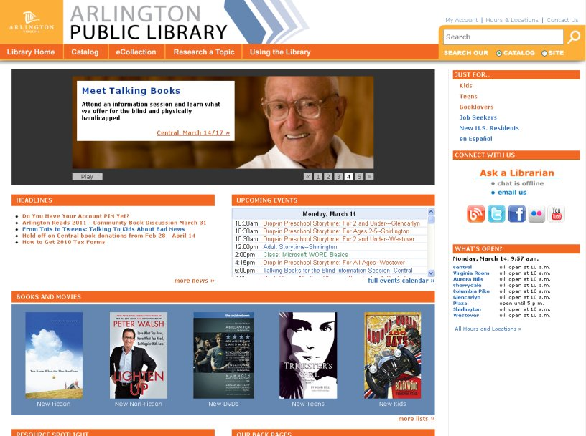
Notes:
And now it looks like this.
One change was purely cosmetic – we convinced the County’s IT Department to let us put our own logo at the top of the website template
That was huge, but it isn’t what made the biggest difference.
The real change came when we created a News Blog
We moved all the news, events and promotional text to it
Then we linked all of the Headlines on our homepage to our blog posts
For example, if you click on the Meet Talking Books promotion on the homepage, it takes you….

Slide 11
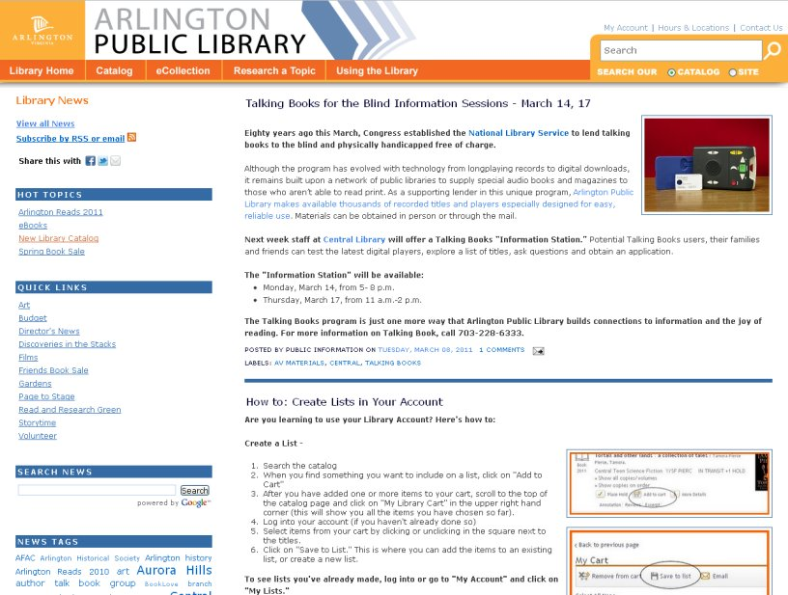
Notes:
…to a News post with all the details about this event.
This is our News Blog
Note that it looks JUST like the Library website. Unless you check the URL, you don’t even know that you’ve left our official County site.
When we write a News article on the blog, we tag it “homepage” if we want it to appear in the headlines that display on the Homepage. The homepage headlines are powered by RSS.
We also use tags to send posts out to other places, where our patrons are likely to see them

Slide 12
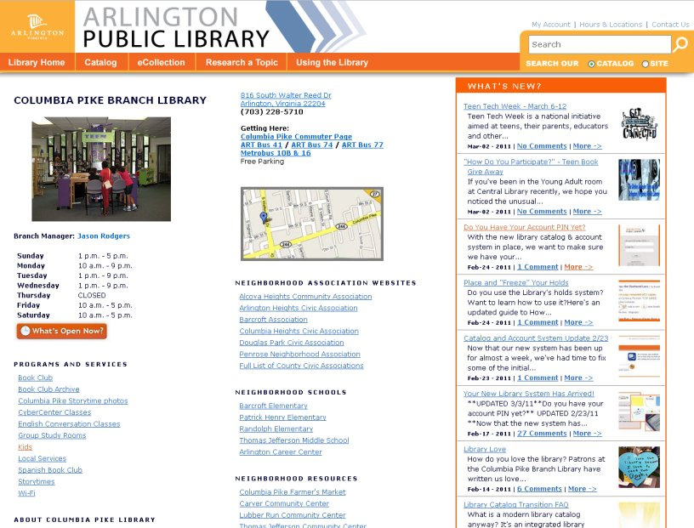
Notes:
…like the Library Branch pages
So anything tagged “Columbia Pike” on the News Blog gets sent to the Columbia Pike Branch Page.
The branch pages used to be just hours and phone numbers
And yet they got some of the highest traffic on our site
Now patrons looking for info on the Columbia Pike Branch Library also find News about Columbia Pike

Slide 13
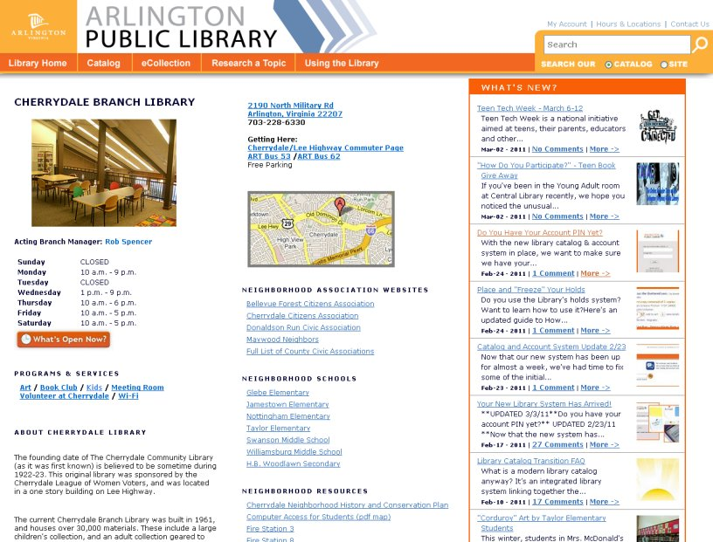
Notes:
Same for the Cherrydale Branch….

Slide 14
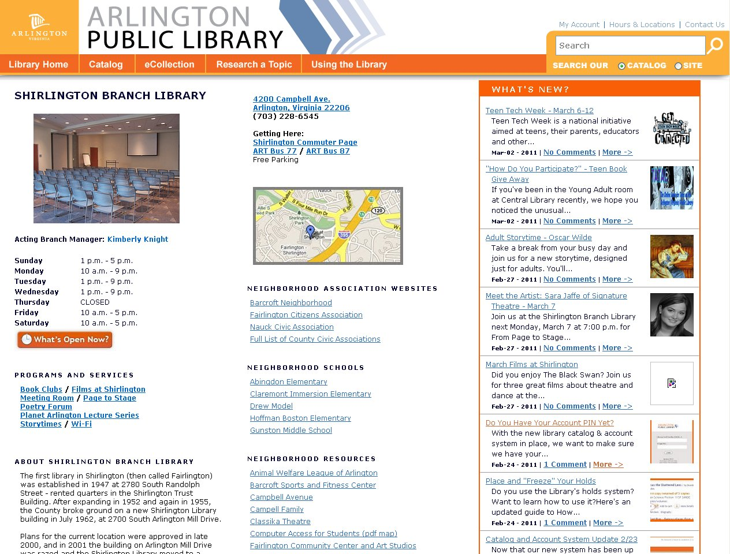
Notes:
And the Shirlington Branch….and so on.
So the key to the effectiveness of the News Blog is that we channel people to it from popular places.

Slide 15
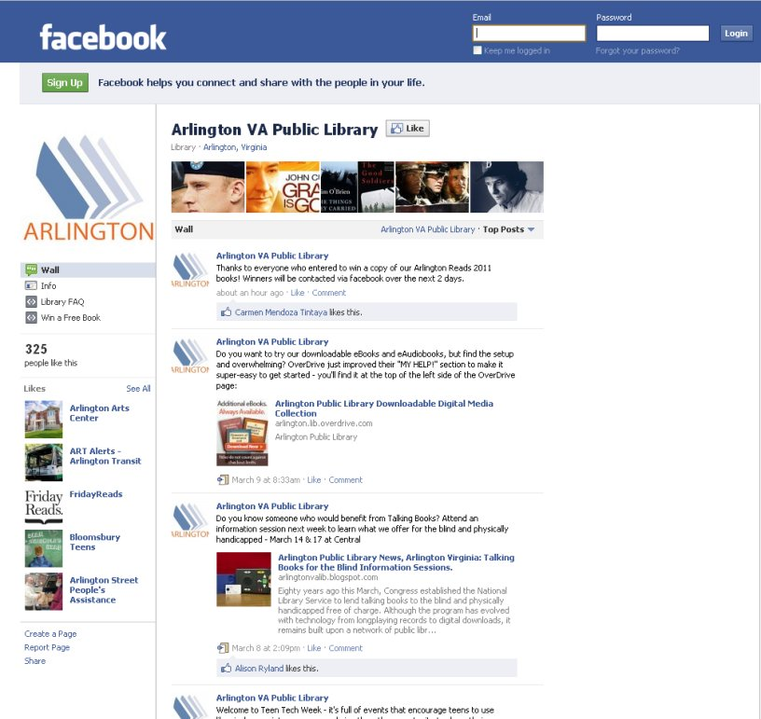
Notes:
Including our Facebook page
We don’t auto-post from our blog to our facebook page
We summarize the news so that followers don’t have to go any further
But we link back to the News Blog for people who want more info

Slide 16
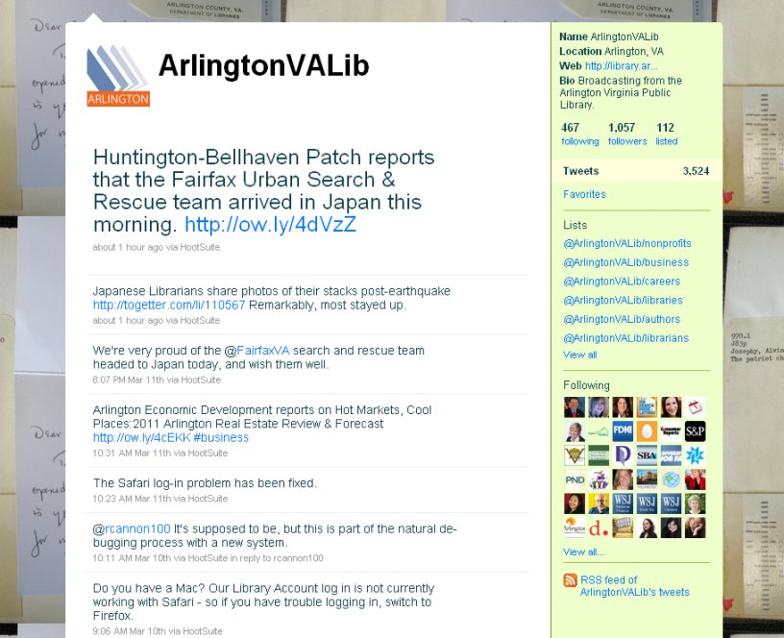
Notes:
We do the same with Twitter.
We also use Twitter to share information on anything local and literary that we think our readers are interested in
This helps create our online Library personality

Slide 17
Notes:
At this point we want to emphasize that we didn’t replace the homepage with the News Blog – we integrated the two.
We used a free blog to act as a secondary content management system for our site
Using the blog gives us access to functionality like integrated commenting, tagging and archiving, which are not features of our County-provided system
We did contemplate the wisdom of putting our News content on Google instead of the official County site –
Because if Google goes away, our News Blog goes with it….
But we decided that if Google goes away, we most likely have MUCH bigger problems.
Also – ONLY our news content is on blogger, and we were willing to risk losing it

Slide 18
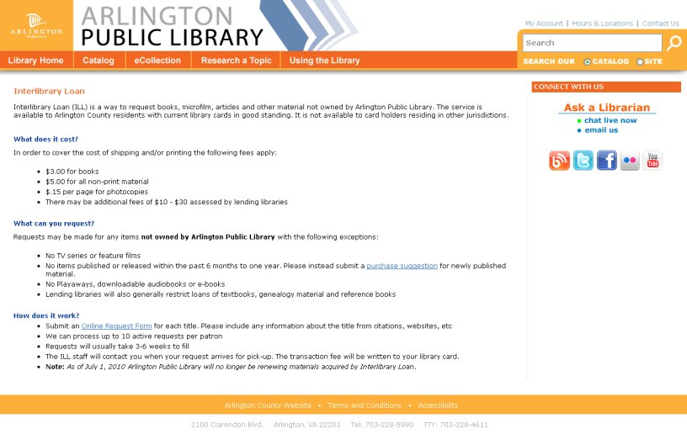
Notes:
Important Static information remains on the actual website.
Like Policies + Services information

Slide 19
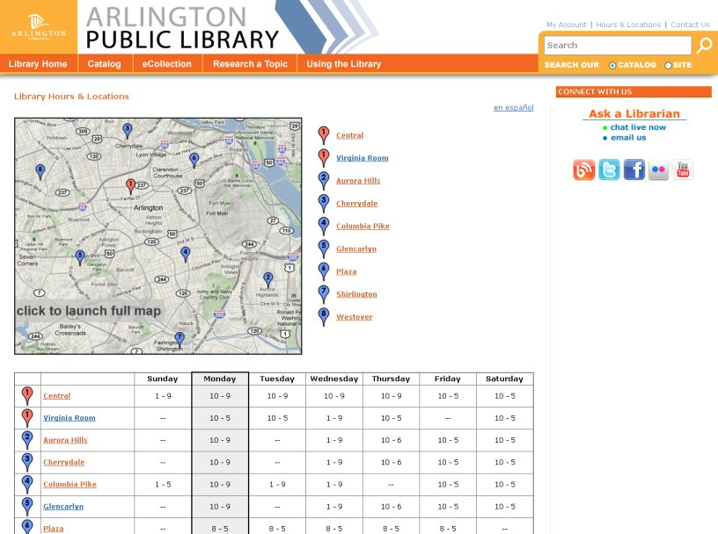
Notes:
Hours and Locations, and that sort of thing

Slide 20
Notes:
So what does go on the blog?
Lots of News and Event Information about -
Art exhibits
Author Events
Budget updates
System outage messages
Photos and video of past events
Anything else that’s interesting but not permanent
These are things that could have been press releases in the past – now they’re News Blog articles
Once we started using the blog to promote the programs our users were already interested in – like Summer Reading, our Annual One Book Program, our Used Book Sales - we had a huge, instant audience reading it.

Slide 21
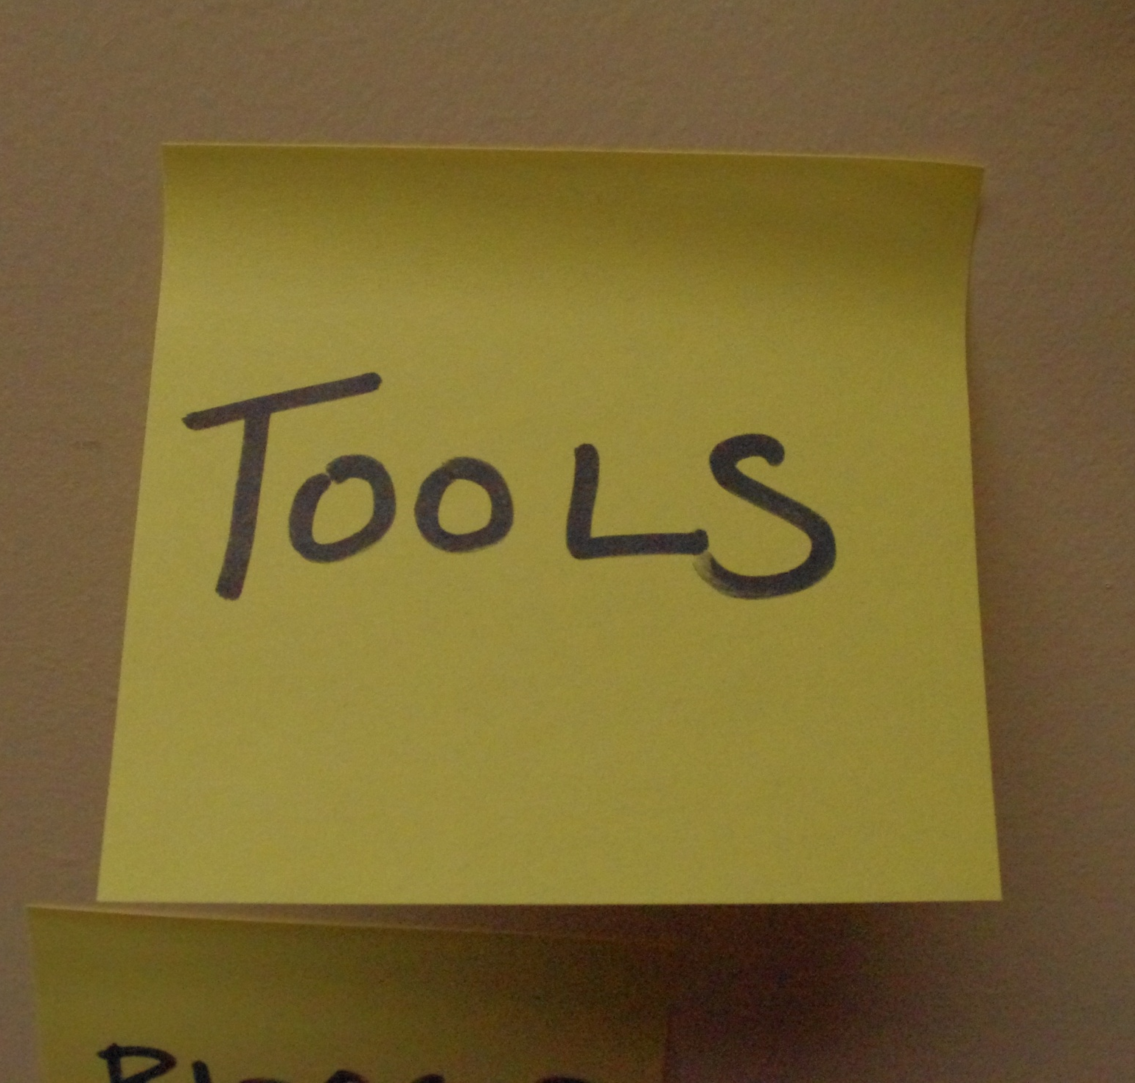
Notes:
So how did we do this? What tools did we use?
We went for the FREE stuff.

Slide 22

ALL FREE STUFF
Notes:
We chose Google’s Blogger for our News Blog.
This may surprise you, because it’s not known to be the most sophisticated platform
BUT it has a few great advantages –
It’s really easy to use
This was crucial because we wanted to recruit other – less tech savvy staff – to write for our blog
And it supports tagging really well

Slide 23

ALL FREE STUFF
Notes:
This was important because, by using the free Yahoo Pipes tool
We can filter the News Posts by tag
And then create feeds based on those tags

Slide 24
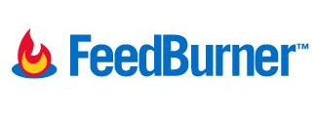
ALL FREE STUFF
Notes:
Then we use FeedBurner to display the tagged feed on the Home Page
And allow people to subscribe to the News Blog by RSS or email

Slide 25
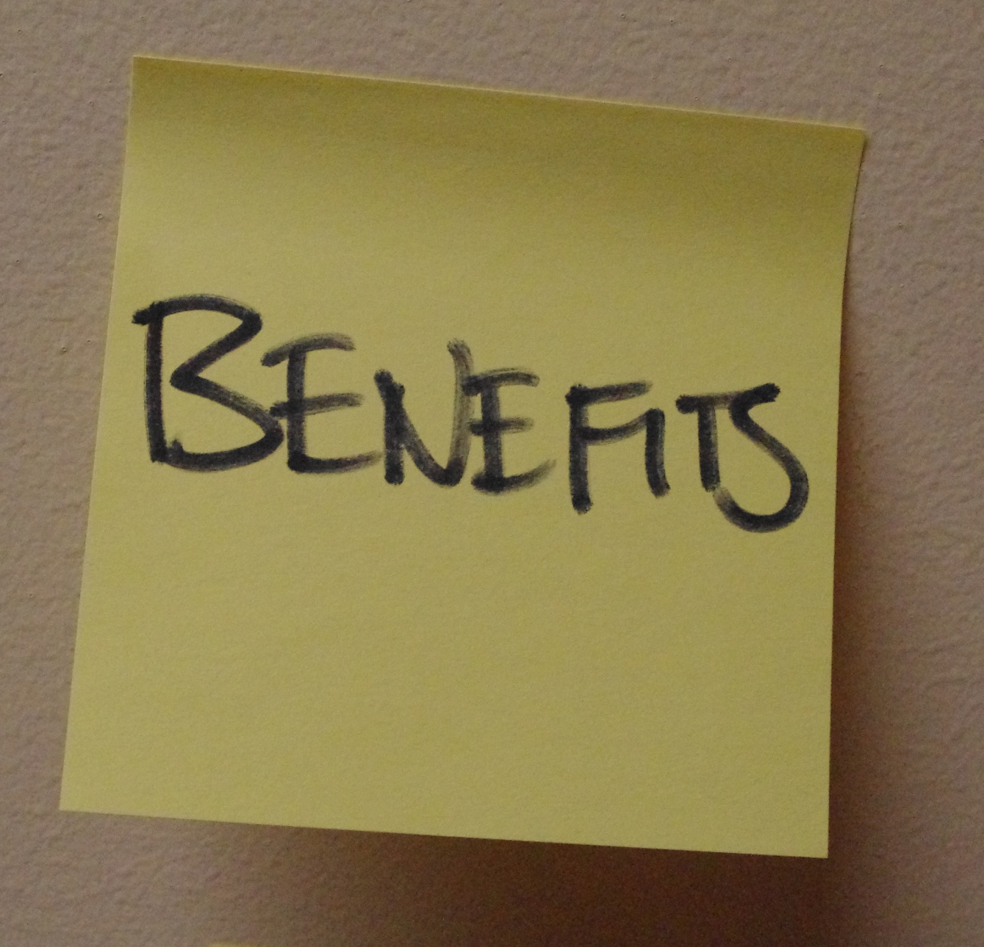
Notes:
So looking back at our goals –
What did we achieve by creating our News Blog this way?

Slide 26
Notes:
Our first goal: we needed a more modern platform to better hold our news and event information
Functionally, the blog platform gives us -
A great “container” for news – each entry gets it’s own page, with a URL for linking and a place for comments
Users can subscribe to our content by RSS or email, or by following us on Facebook or twitter
The Blog is great for posting about emergencies like power outages, because you can post to blogger from your phone
And when a program or initiative comes up, we don’t need to create a whole new platform to talk about it – we just add it to the News Blog, because our audience is already there
The News Blog has become THE PLACE to talk about anything related to our Library

Slide 27
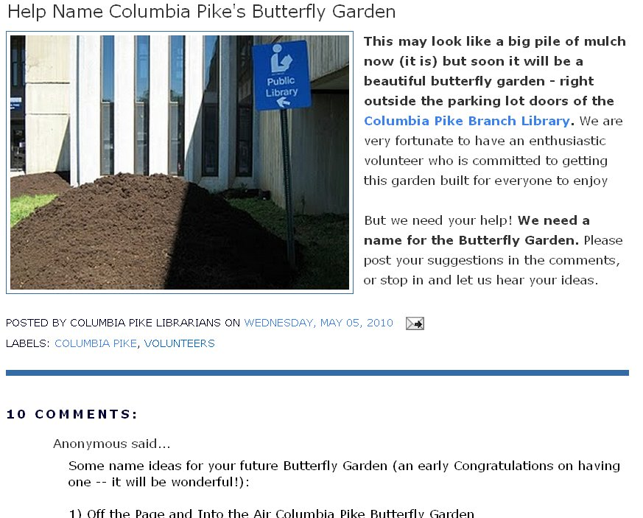
Notes:
And now that we have an built-in audience there’s also room to indulge in the smaller, fun things – like writing about our Butterfly Garden.
This is great because -
Our readers seem to enjoy posts like this
And our statistics show that most people who come to the blog for one piece of news then go on to read more articles

Slide 28
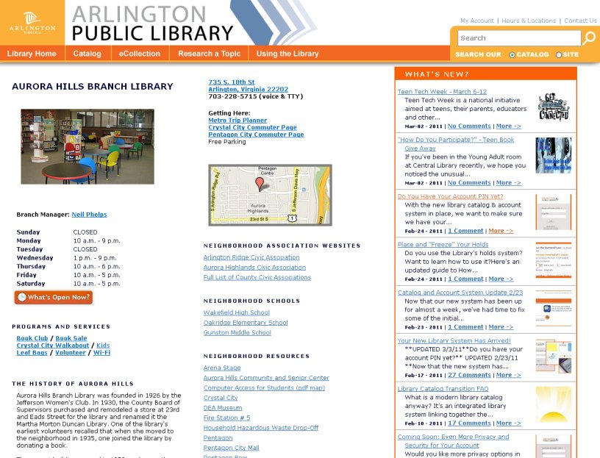
Notes:
Our second goal: We wanted to present the Library as a single system, but also give each of the branches a unique online presence
We did that by filtering the news feed to target specific groups within our larger community
Most branches have a staff member who write posts about things exclusive to their branch or neighborhood
Now visitors to our site who come looking for hours information are finding a vibrant community of other engaged library patrons

Slide 29
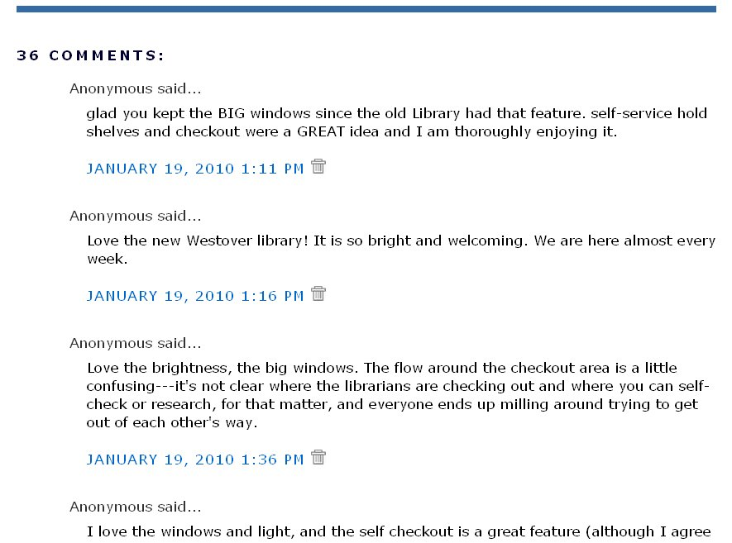
Notes:
Our third goal: We wanted to create a place for community engagement about the Library
This was probably our biggest goal, and our biggest success –
We see comments on many different kinds of posts
Commenting on the News Blog, and on Facebook and Twitter, has actually exceeded our expectations
For example this post - asking our patrons what they thought about a new building - got 36 comments.

Slide 30
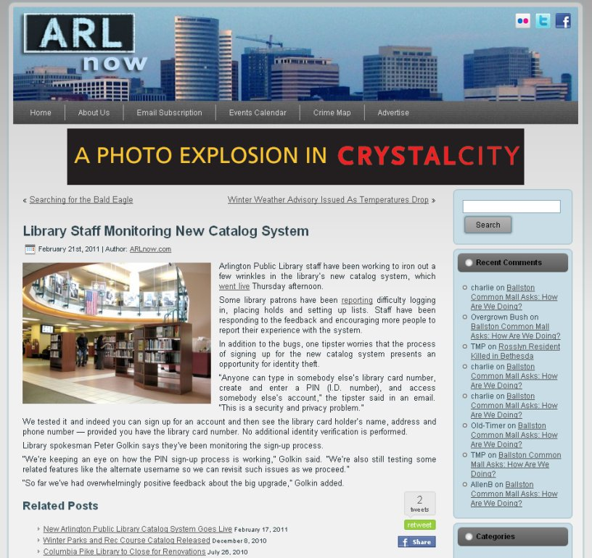
Notes:
We also get lots of coverage from local News Outlets, because they are following our News Blog too
This article is from a local news site. The headline reads “Library Staff Monitoring New Catalog System”
The article linked back to one of our own news posts

Slide 31
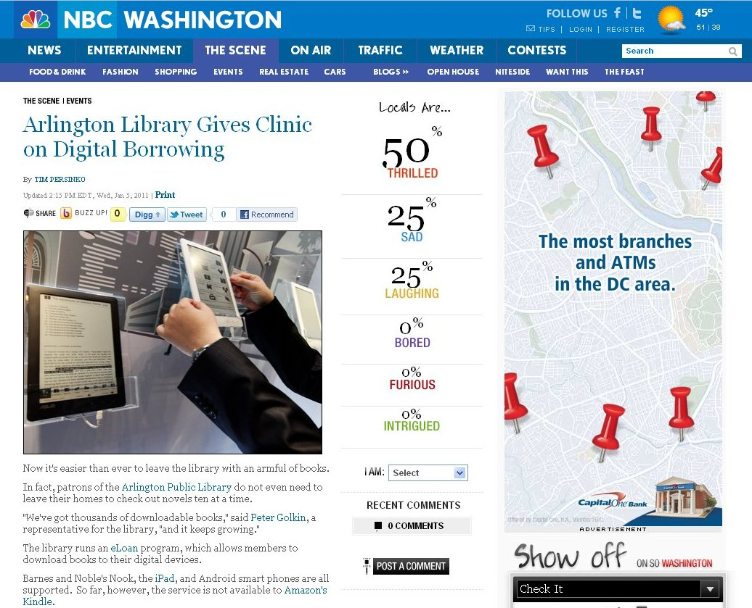
Notes:
We sometimes get picked up by the TV news web sites, too, giving us even more exposure.
This kind of unsolicited news coverage was an unexpected benefit of creating the News Blog

Slide 32
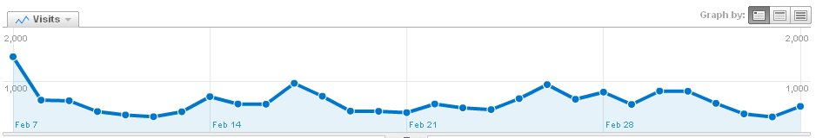
Feb. 2011
Notes:
Last month when we were going through the transition to our new ILS, we saw about 750 visits to the News Blog a day.
Every time we write about a big event, we see a spike in readership that ultimately increases our regular audience.

Slide 33
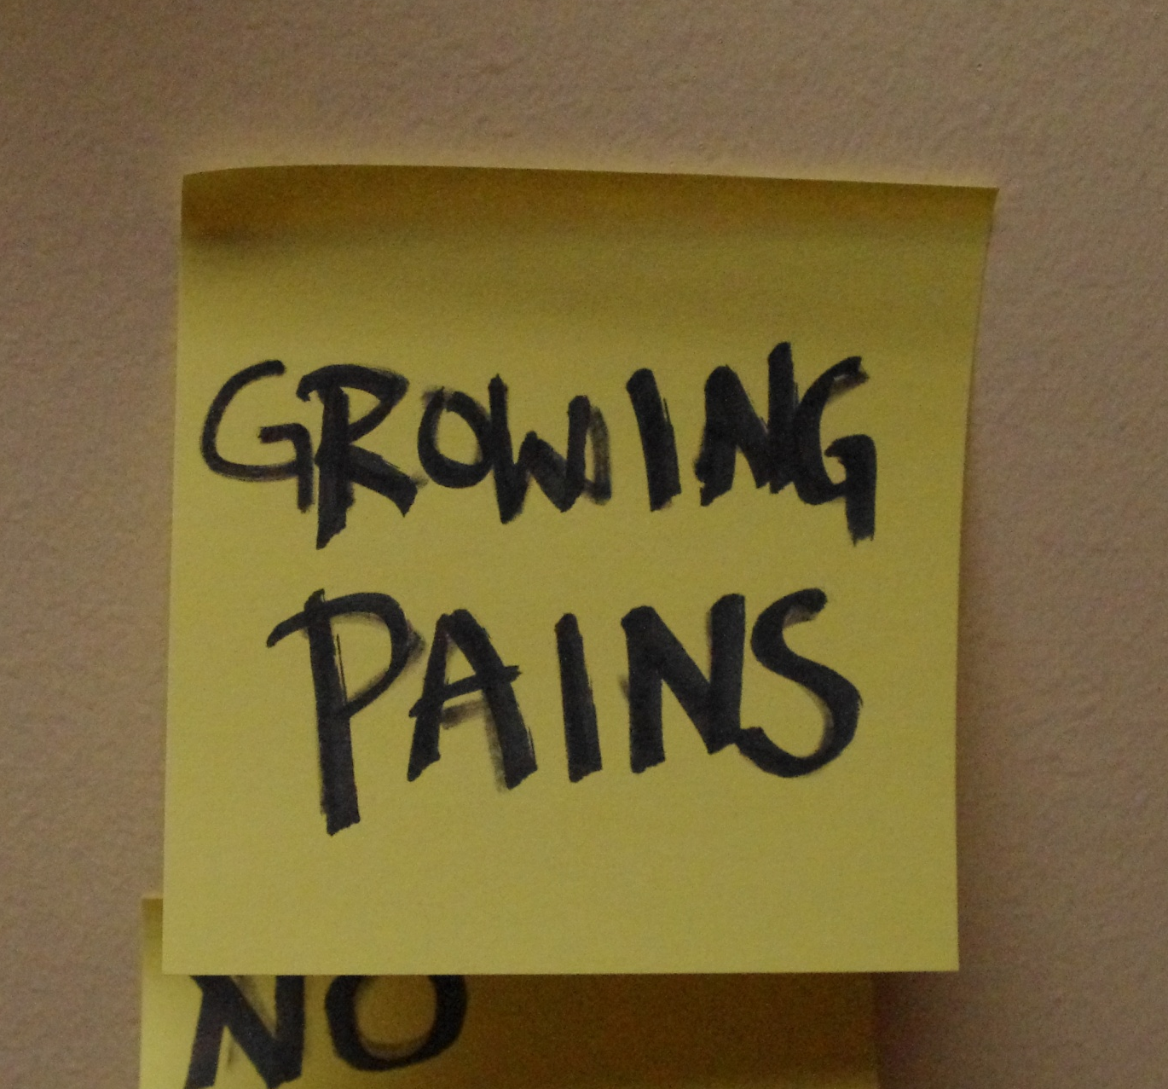
Notes:
However, there have been some growing pains.
Because -
We were inventing this as we went

Slide 34
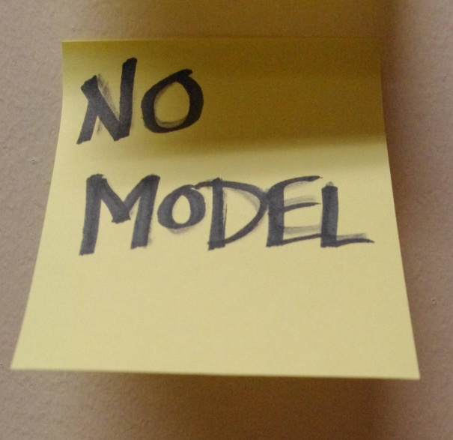
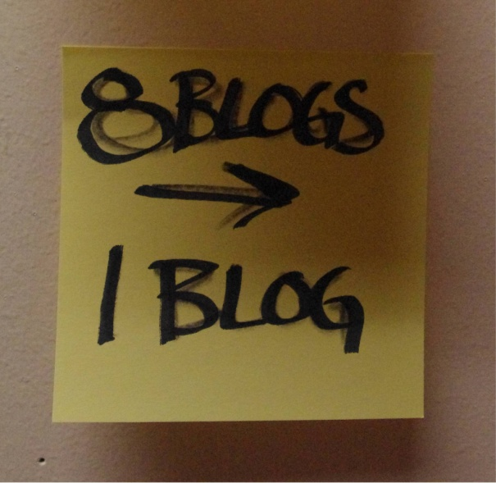
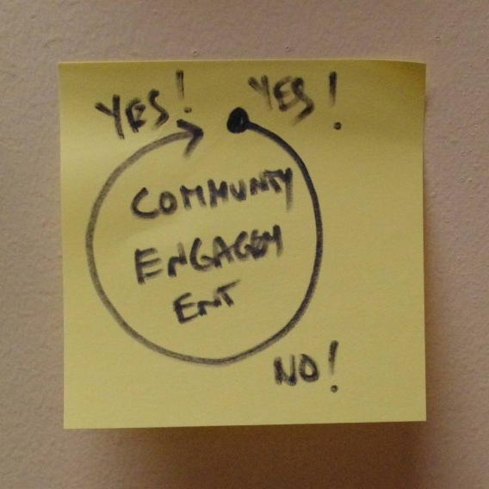
Specifically…
Notes:
We couldn’t find an existing model to follow, and social media engagement was still so new.
Other Libraries had blogs, but we couldn’t find anyone with the network that we were trying to create.
So at first we thought we needed 8 blogs – one for each branch.
During development we realized that a single archive was better than 8 separate silos.
So we only needed One Blog, tagged to send posts out to the branch pages
But our Biggest growing pain was around Community Engagement itself.

Slide 35
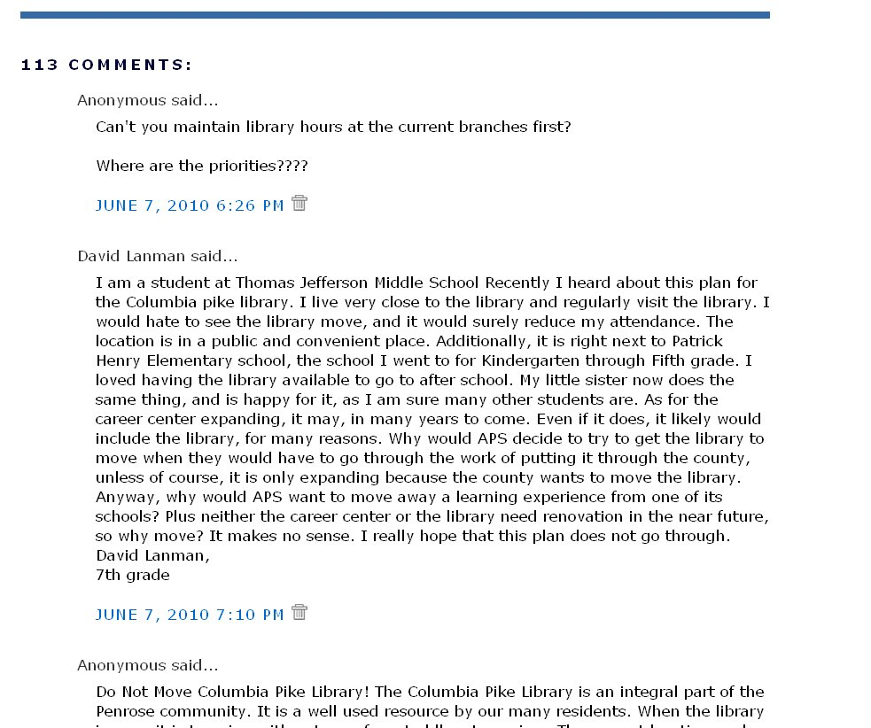
Notes:
One of our most important goals had been to provide a forum for Community Engagement – which we got
Here is a post from last year about a possible Branch Relocation
It was IMMEDEATELY picked up by local media and local listserves
Our first post on the subject got 113 comments, many of which were very unhappy
This was overwhelming to us
It was also very uncomfortable for Library management and for our Public Relations staff
We realized that we’d failed to make sure that Library management was as comfortable being on the receiving end of negative social media engagement as we were
This was when we discovered that we needed a plan to deal with negative community engagement on the News Blog.

Slide 36
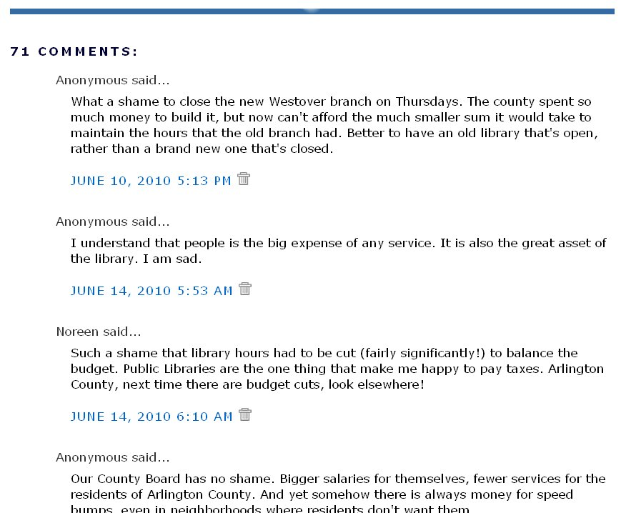
Notes:
Here are a few more examples of Community Engagement Gone Wild -
A post about a change in Library hours got 71 comments – some unhappy, some supportive.

Slide 37
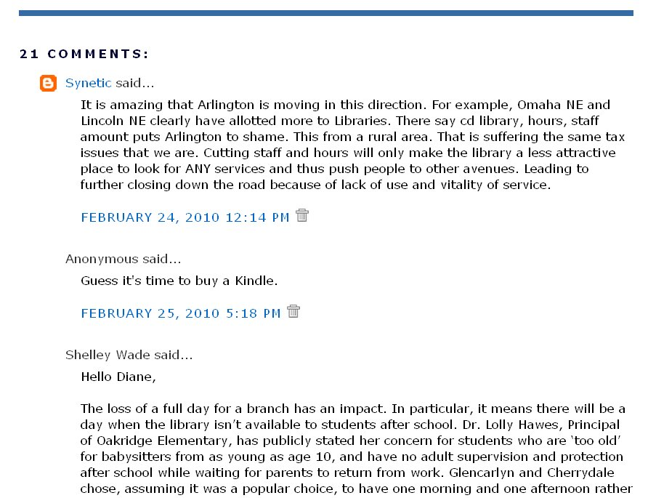
Notes:
And a post about the impact of the Library budget cuts got 21 comments.
Cleary, our patrons were becoming comfortable interacting with us on the News Blog, but no everyone was on their best behavior.

Slide 38
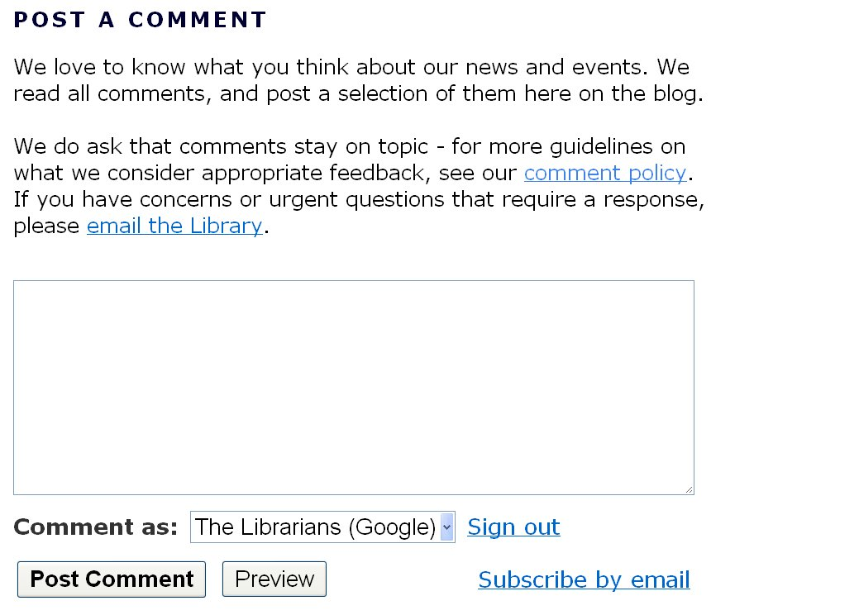
Notes:
So the first thing we did was refine our comment policy, to give us greater discretion in moderating comments.

Slide 39
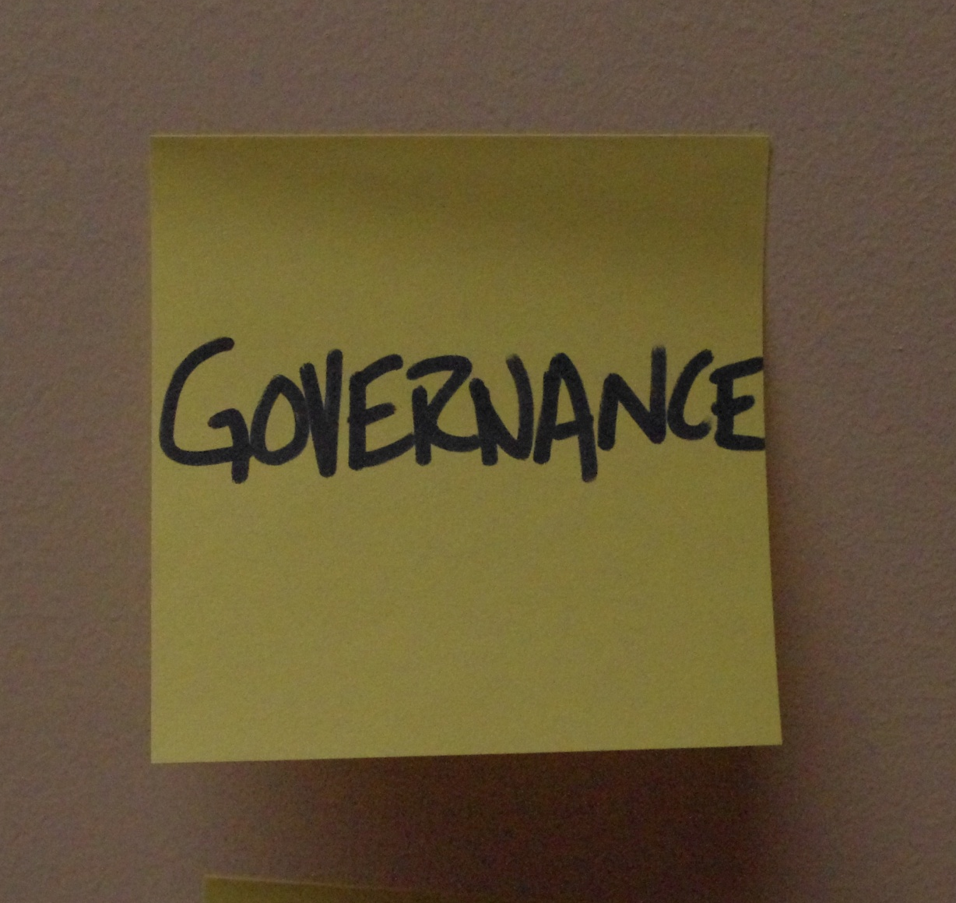
Notes:
Then we worked with Library Management to create a Governance plan for how we use the News Blog for Community Engagement

Slide 40
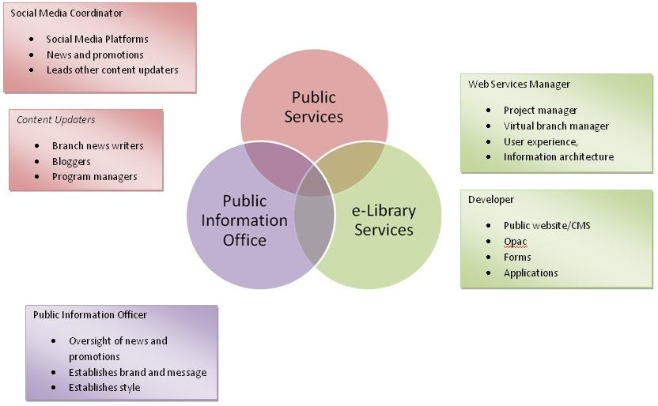
Notes:
This is when we established the role of News Blog editor (me!)
And we clarified how that position works in conjunction with PR and Web staff

Slide 41
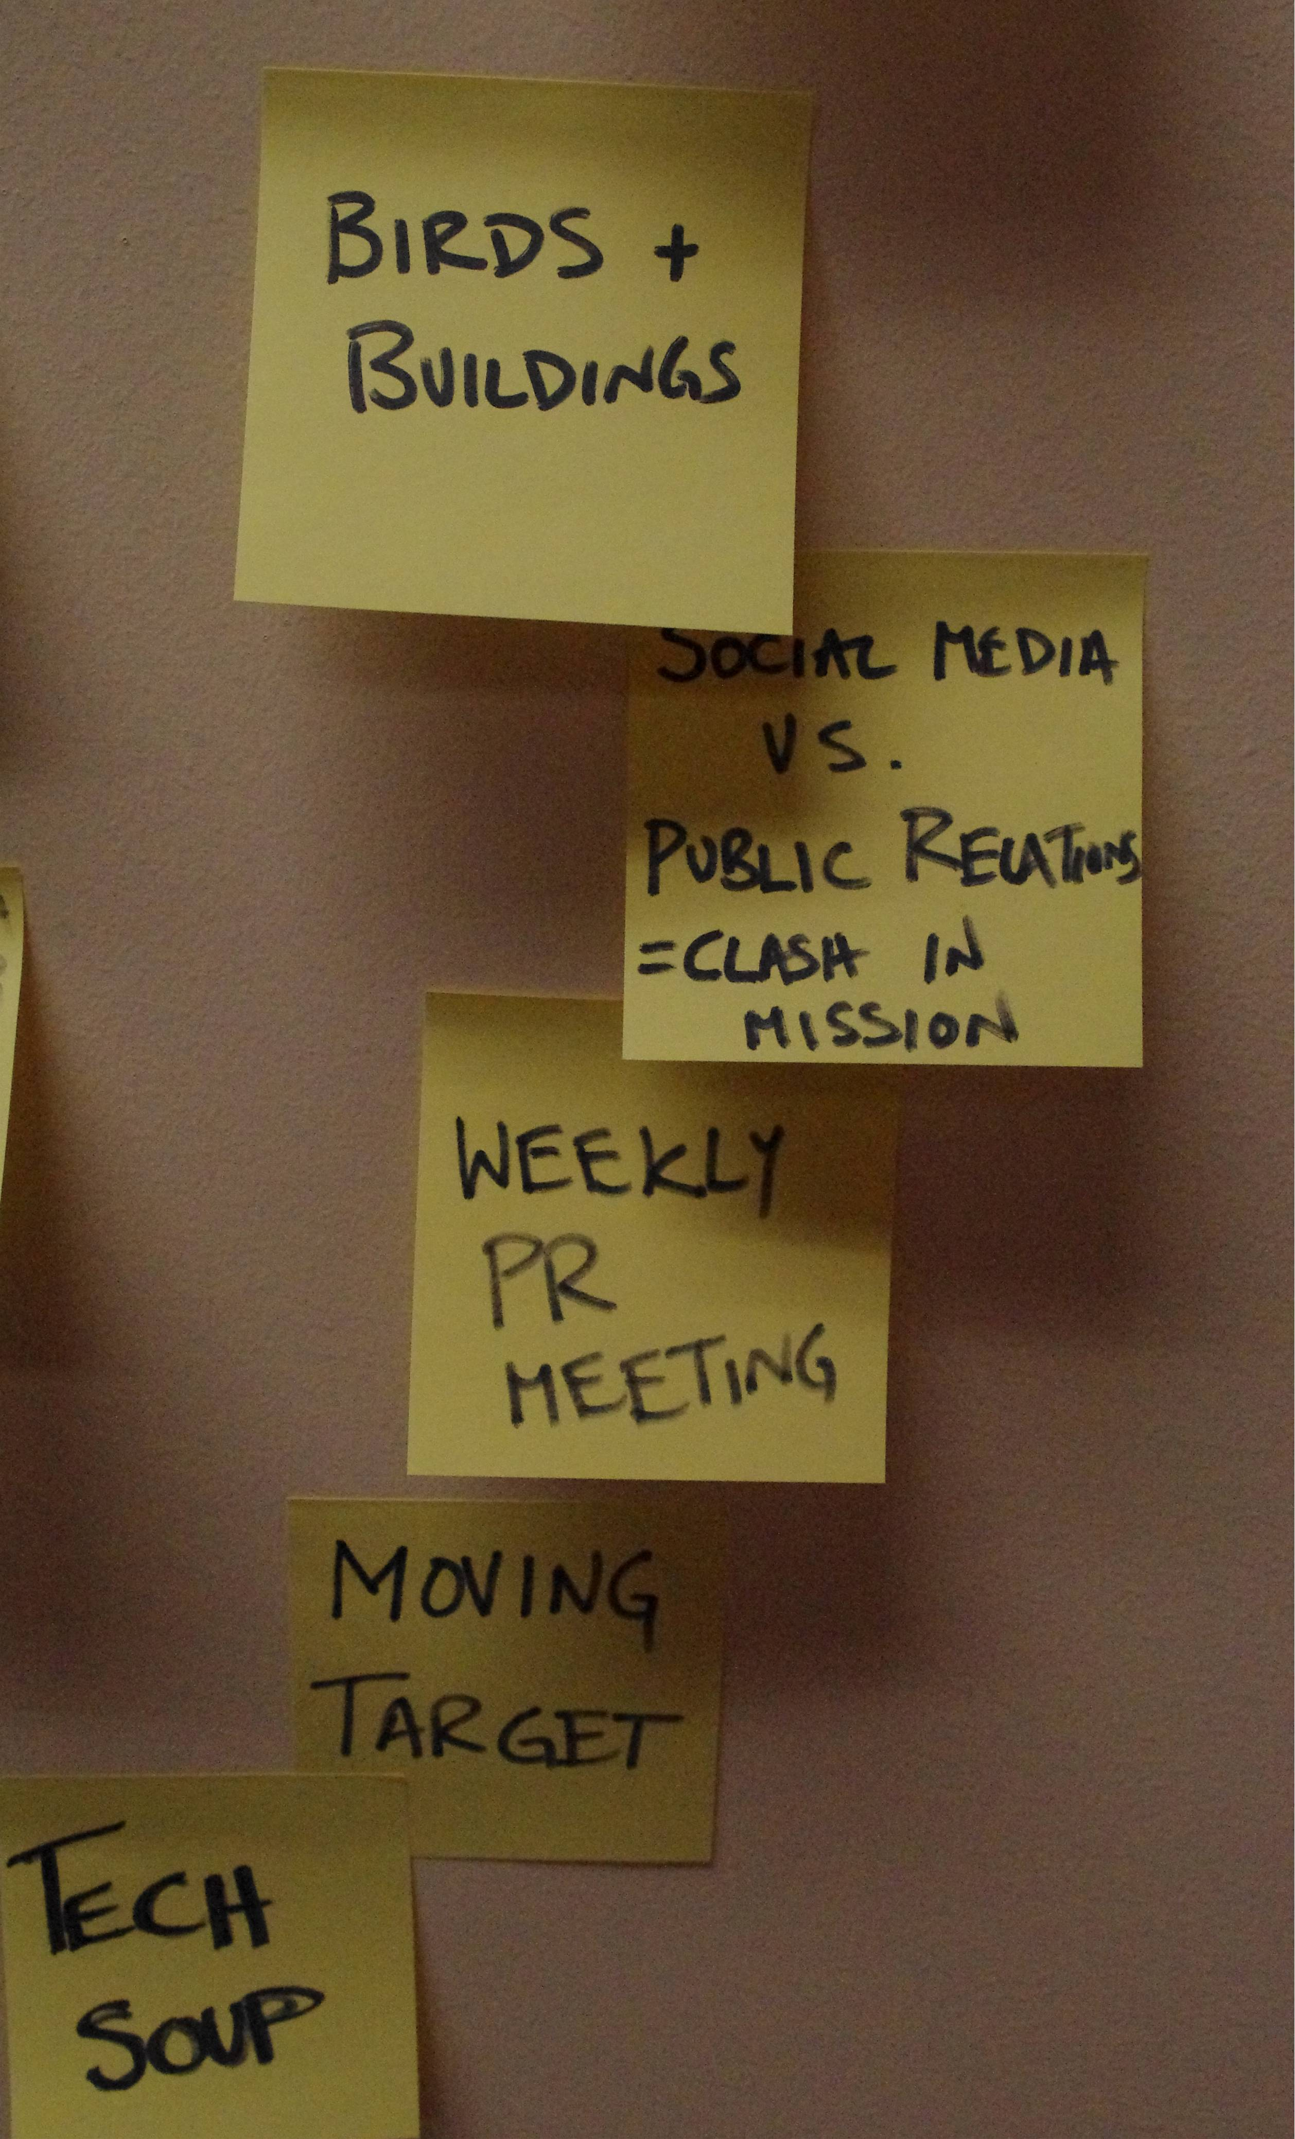
Notes:
We also defined how to handle sensitive issues –
Like the budget
Building hours and operations
And Birds
You’re probably wondering how Birds can possibly be a sensitive issue
One Busy summer Saturday morning while I was working, a bird was found wandering the stacks at our Central Library.
As the social media coordinator, I thought this would be the perfect thing to tweet about. Especially since the patrons were enjoying the spectacle as staff tried to catch the bird, and even documenting the event with their own camera phones, which they no doubt then uploaded to facebook and twitter themselves.
So I put updates about the bird chase up on twitter throughout the day. Animal Control eventually liberated the bird by mid-afternoon.
All was well until Monday morning when the Library’s Public Information Officer pointed out all of the possible liabilities involved in publicizing wild animals in the Library.
After much back and forth, we agreed that in the future I would get permission before posting about birds and other potentially sticky issues. We now call this the “Birds and Buildings” rule.

Slide 42
Notes:
Our Governance evolution also includes:
A weekly PR Meeting with Social Media, Web and PR staff
And a monthly “Tech Soup” Meeting of staff who contribute to the News Blog (about 6-10 people)

Slide 43
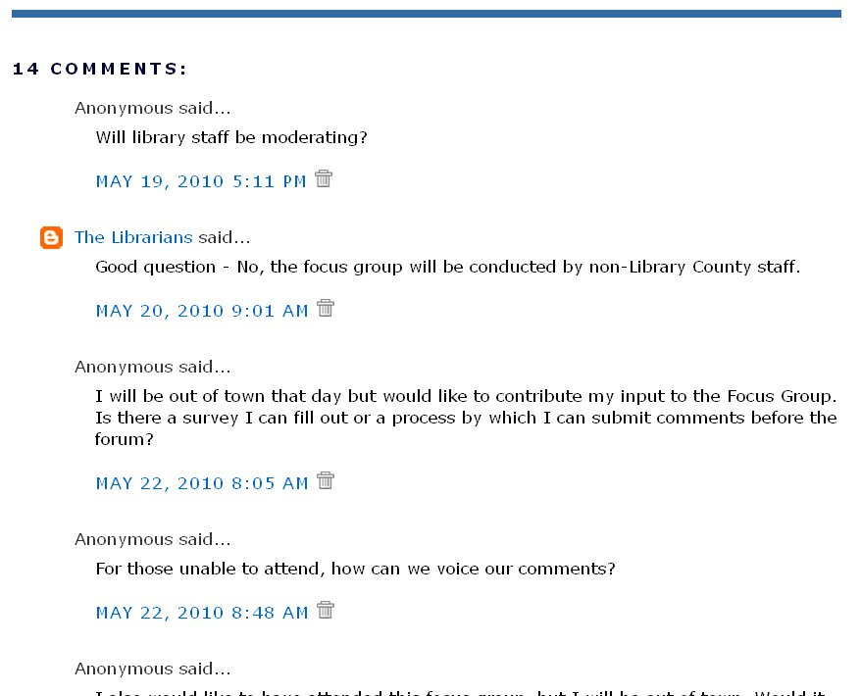
Notes:
One thing we do differently now that we have better governance is give as much information as possible when we write posts.
This is a post from last May, about a focus group that was being conducted on the Future of the Library -
It got a dozen questions about how the focus group was being run, the purpose, how to participate if you weren’t available that day, etc.
This taught us to anticipate reader questions when writing News Posts, and to be proactive about trying to answer those questions from the outset
We call this the “what, when, why” rule
This may seems obvious, but at the time we were still used to writing for static media where reader feedback isn’t so instantaneous

Slide 44
Why this works
Tight Integration
Holistic Strategy
Magnetic Content
Good Governance
Notes:
It might sound like we’re suggesting something really obvious – Just use a blog
So what makes this approach special?
Our blog has tight integration with our existing website; in terms of look and feel, navigation and links
We employ a holistic social media strategy that points patrons to the News Blog from places they frequently visit
We leverage magnetic content; the content our patrons are looking for is always on the News Blog. Once they find it, they’ll also see other content we’re trying to promote
We developed good governance and well-defined roles for staff. A successful blog needs someone to own it, and we’ve made that an official role in our organization.

Slide 45
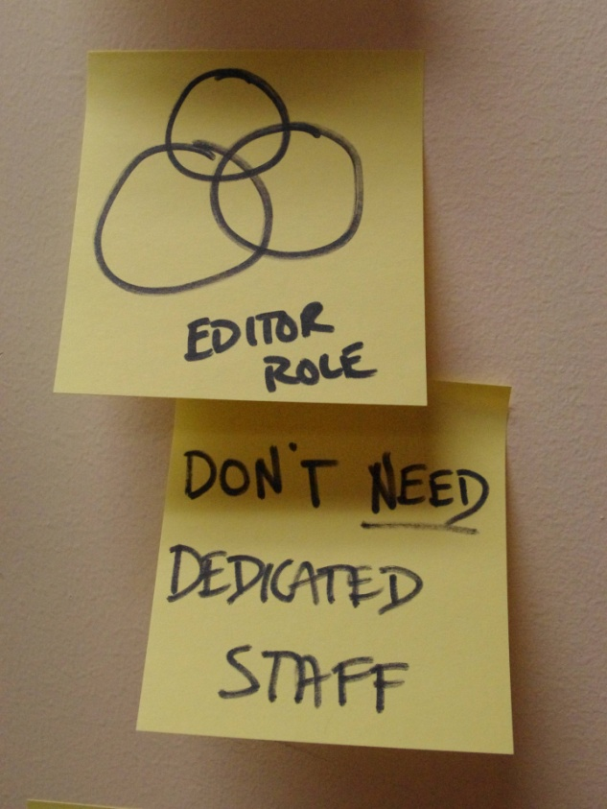
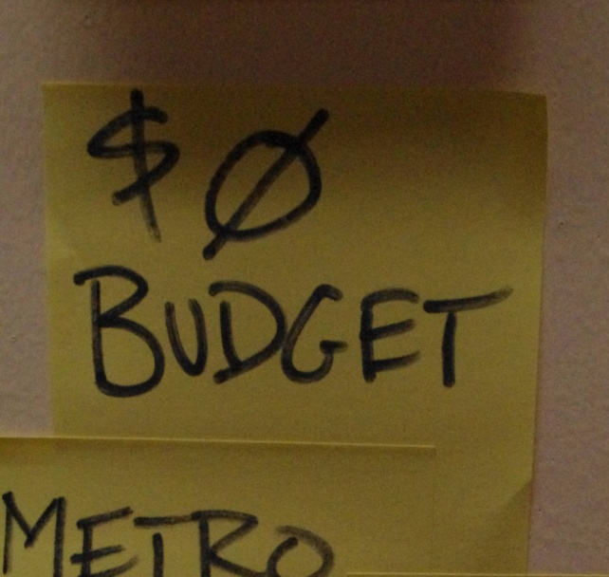
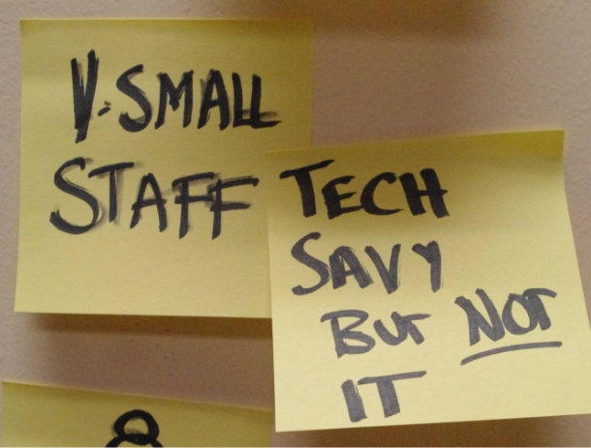
You can do this too
Notes:
You may have different constraints than we do, so our solution may not be yours.
But we hope we’ve demonstrated that - with a little creativity - there are ways to leverage free tools to get really great results on a shoestring.

Slide 46
This is all live on our website http://library.arlingtonva.us
Presentation and notes on CIL site
Notes:
And if you want to know more…
You can see our integrated blog and website structure in action on our website
And our full presentation including our notes is now up on the conference presentation site

Slide 47
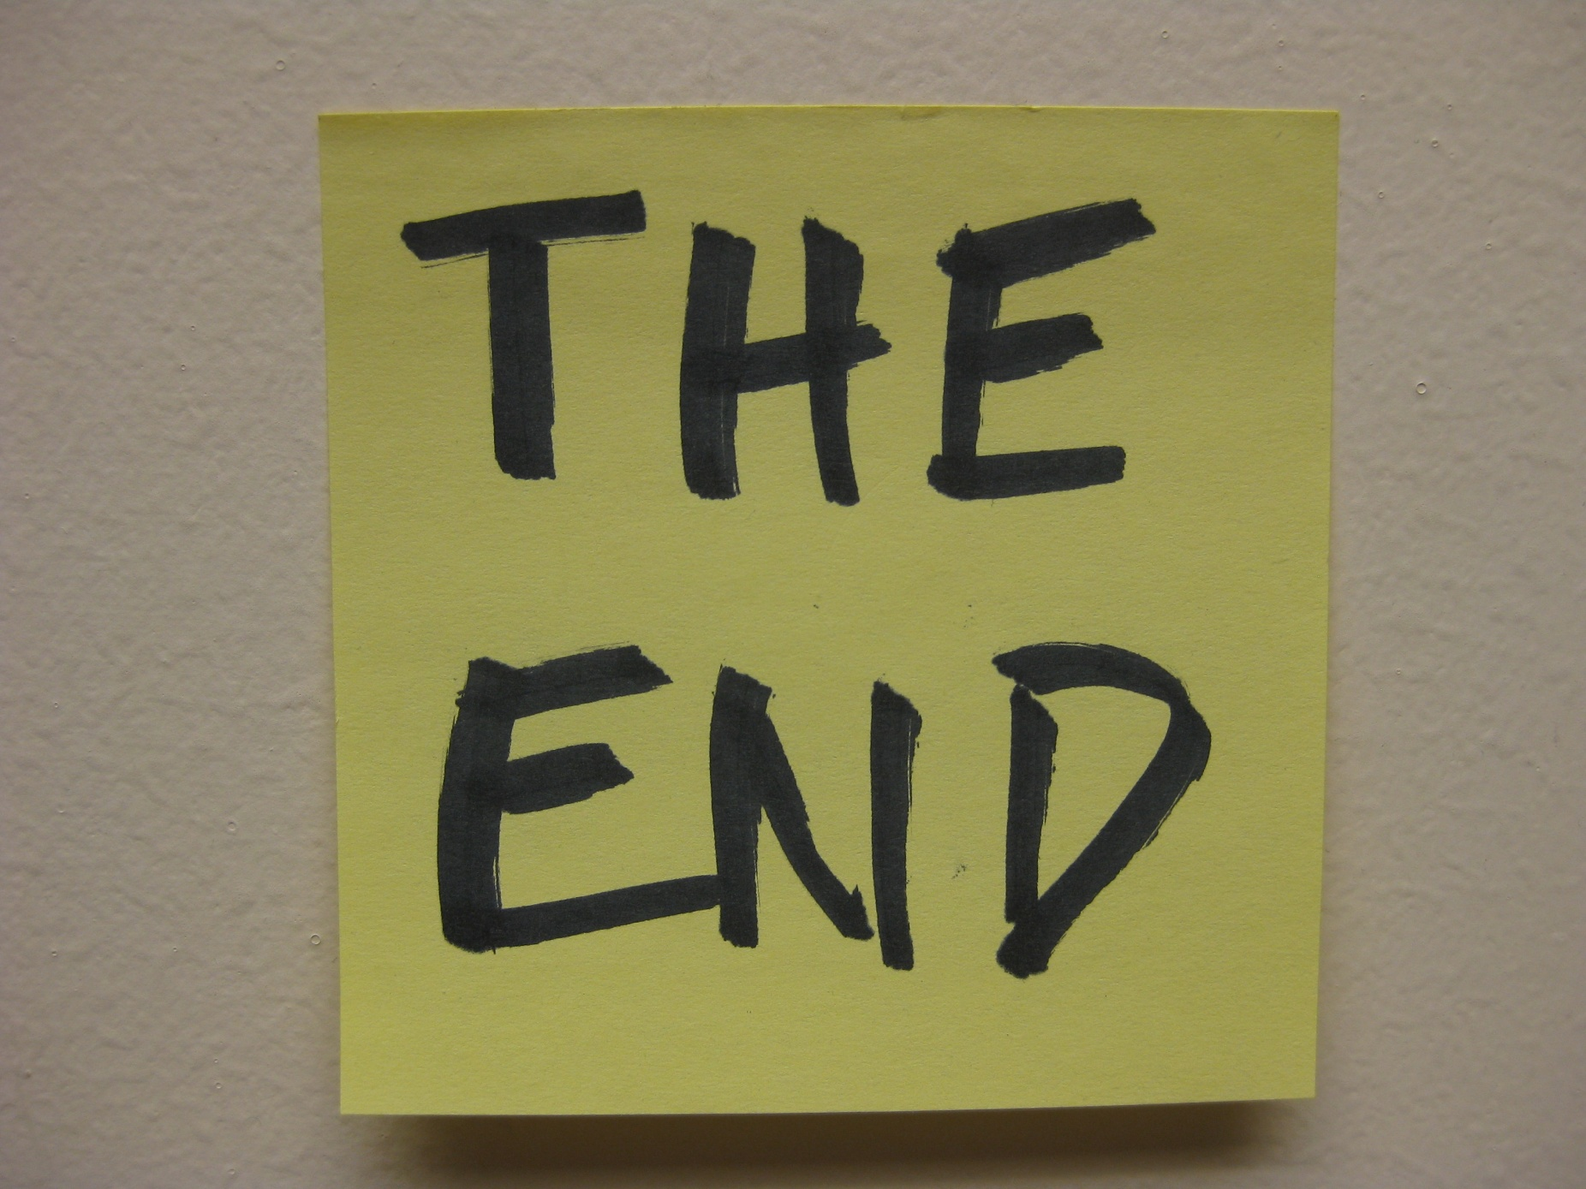
Notes:
Any questions?

